Slide 1
.NET/C# Training
Parthiban
24/10/2023
Notes:
This template can be used as a starter file for presenting training materials in a group setting.
Sections
Right-click on a slide to add sections. Sections can help to organize your slides or facilitate collaboration between multiple authors.
Notes
Use the Notes section for delivery notes or to provide additional details for the audience. View these notes in Presentation View during your presentation.
Keep in mind the font size (important for accessibility, visibility, videotaping, and online production)
Coordinated colors
Pay particular attention to the graphs, charts, and text boxes.
Consider that attendees will print in black and white or grayscale. Run a test print to make sure your colors work when printed in pure black and white and grayscale.
Graphics, tables, and graphs
Keep it simple: If possible, use consistent, non-distracting styles and colors.
Label all graphs and tables.

Slide 2

Software use cases
Why should I use
Notes:
Give a brief overview of the presentation. Describe the major focus of the presentation and why it is important.
Introduce each of the major topics.
To provide a road map for the audience, you can repeat this Overview slide throughout the presentation, highlighting the particular topic you will discuss next.

Slide 3

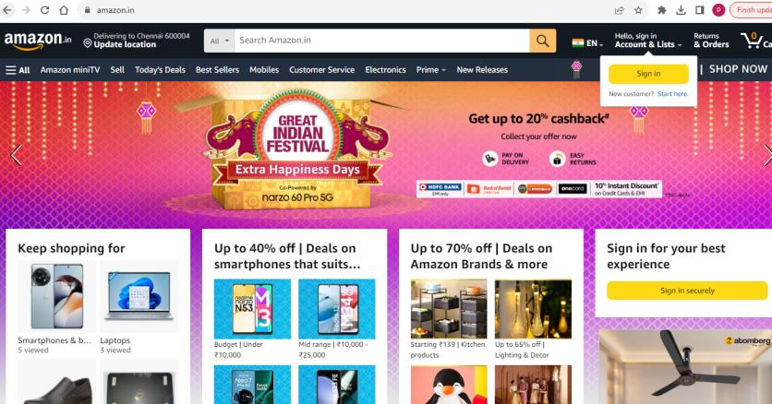
Amazon
Order Time Compare to In person Purchase
Notes:
This is another option for an Overview slides using transitions.

Slide 4
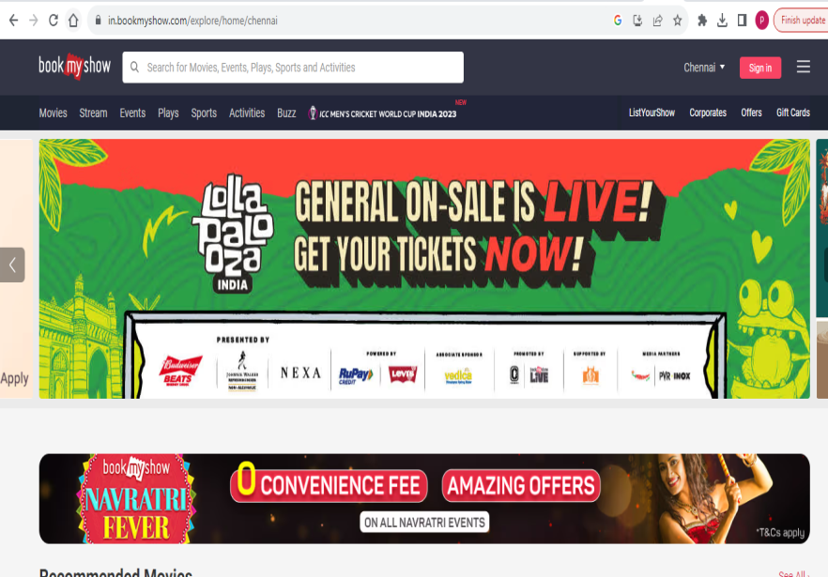
Book My Show – Ticket Booking

Slide 5
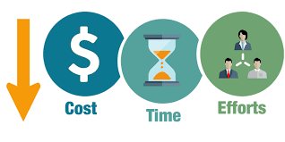
Software use cases
Cost
Time
Efforts
Notes:
Give a brief overview of the presentation. Describe the major focus of the presentation and why it is important.
Introduce each of the major topics.
To provide a road map for the audience, you can repeat this Overview slide throughout the presentation, highlighting the particular topic you will discuss next.

Slide 6
Types Of Applications
Console Application
Windows Applications
Web Applications
Mobile Applications
Notes:
Give a brief overview of the presentation. Describe the major focus of the presentation and why it is important.
Introduce each of the major topics.
To provide a road map for the audience, you can repeat this Overview slide throughout the presentation, highlighting the particular topic you will discuss next.

Slide 7
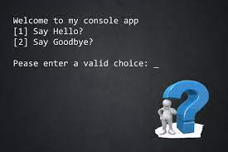
Console Application
Automation
TFS
Windows Components
Notes:
Give a brief overview of the presentation. Describe the major focus of the presentation and why it is important.
Introduce each of the major topics.
To provide a road map for the audience, you can repeat this Overview slide throughout the presentation, highlighting the particular topic you will discuss next.

Slide 8
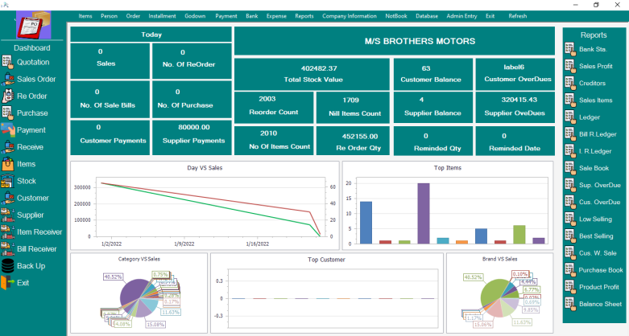
Windows Applications
Billing
Invoice Software
Notes:
Give a brief overview of the presentation. Describe the major focus of the presentation and why it is important.
Introduce each of the major topics.
To provide a road map for the audience, you can repeat this Overview slide throughout the presentation, highlighting the particular topic you will discuss next.

Slide 9
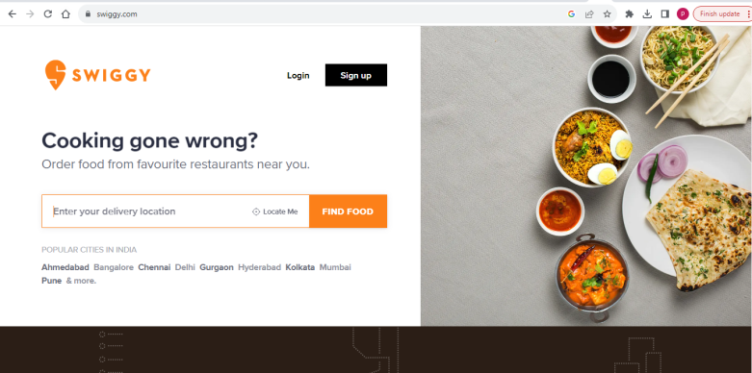
Web Applications
Food Order
eCommerce
Notes:
Give a brief overview of the presentation. Describe the major focus of the presentation and why it is important.
Introduce each of the major topics.
To provide a road map for the audience, you can repeat this Overview slide throughout the presentation, highlighting the particular topic you will discuss next.

Slide 10
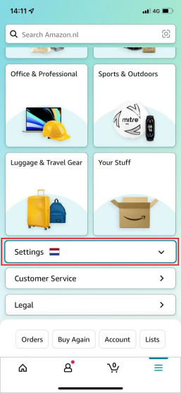
Mobile Applications
Amazon
FlipKart

Slide 11
Application
Front End
Middle Layer
Back End
HTML
Javascript
Jquery
Angular
React
.Net
.Net Rest API
Java Services
Database : SQL Server,Oracle, MySQL, Mongo

Slide 12
BookMyShow Web Application
Front End
Middle Layer
Back End
Angular
.Net Rest API
Database : SQL Server

Slide 13
What is .NET
NET
.NET is a free, cross-platform, open source developer platform for building many different types of applications.
With .NET, you can use multiple languages, editors, and libraries to build for web, mobile, desktop, games, IoT, and more.
Languages
We can write .NET apps in C#, F#, or Visual Basic.
C# is a simple, modern, object-oriented, and type-safe programming language.
F# is a programming language that makes it easy to write succinct, robust, and performant code.
Visual Basic is an approachable language with a simple syntax for building type-safe, object-oriented apps.
Notes:
Give a brief overview of the presentation. Describe the major focus of the presentation and why it is important.
Introduce each of the major topics.
To provide a road map for the audience, you can repeat this Overview slide throughout the presentation, highlighting the particular topic you will discuss next.

Slide 14
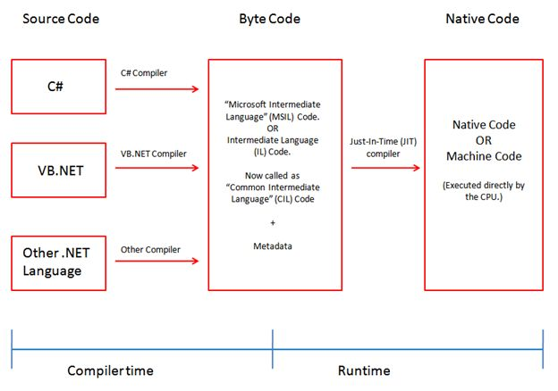
.NET Compilation
Notes:
Give a brief overview of the presentation. Describe the major focus of the presentation and why it is important.
Introduce each of the major topics.
To provide a road map for the audience, you can repeat this Overview slide throughout the presentation, highlighting the particular topic you will discuss next.

Slide 15
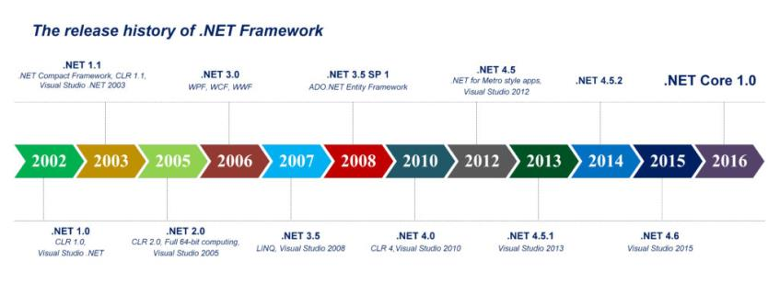
.NET History
Notes:
Give a brief overview of the presentation. Describe the major focus of the presentation and why it is important.
Introduce each of the major topics.
To provide a road map for the audience, you can repeat this Overview slide throughout the presentation, highlighting the particular topic you will discuss next.

Slide 16
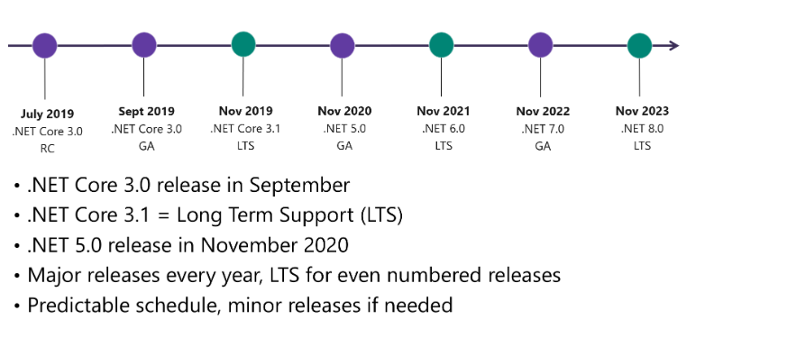
.NET History
Notes:
Give a brief overview of the presentation. Describe the major focus of the presentation and why it is important.
Introduce each of the major topics.
To provide a road map for the audience, you can repeat this Overview slide throughout the presentation, highlighting the particular topic you will discuss next.

